Slide 1
React State Management
Built-In State Management
Notes:
What I’ll be presenting on today is React State Management:
We’ll talk about:
What state management is and why its important
What React provides for us out of the box to manage our application’s state (this will include some of what we saw in Dave’s presentation a few weeks ago)
And briefly touch on a couple of other popular libraries written to help us manage state, such as Redux like we have in some of our applications here
Some of these examples will be straight from the React docs, so I’ll provide links at the end if you’re want to re-review or dig deeper into anything we look at

Slide 2
Why talk about State Management?
UI and State are fundamental elements of any application
Notes:
So, why are we talking about state management?
Well:
UI and state are fundamental elements of any application, let’s think about this quote from a training site I use ui.dev

Slide 3
“If you were to boil down an app to its two most fundamental components, what you'd get is UI and State. An app is composed primarily of UI and State.”
Tyler McGinnis, ui.dev
Notes:
“If you were to boil down an app to its two most fundamental components, what you'd get is UI and State.”
So, what that quote is saying is that, two core elements of any app are the UI you interact with, and the state changes that occur when you interact with that UI.
If you think about the business rules in an app, again, it’s our state that changes in coordination with those rules, our business logic
So, an app is composed primarily of UI and State.
Now, here’s some more on the quote from above:
“if you were to boil down the root cause for any bug you've ever written, odds are that bug was caused because of state mismanagement. The state the app expected and the state it got were out of sync.
Have you ever thought about why the first rule of tech support is turning it off and back on again? It's because it resets the state and, therefore, fixes the problem.”
So, by increasing the predictability of your state, you can decrease the number of bugs in your application.
And that’s some of why we can make the claim that state management in our applications is important.
- https://ui.dev/c/redux/what-is-the-redux-store

Slide 4
Built-In State Management in React
Notes:
All right, so
Now that we understand why state management is important, let’s talk about the state management tools we’re given out of the box with React.
But before we do that,
One other important thing to understand about React is that it embraces and emphasizes declarative programming, as opposed to imperative programming,
And, this is why as someone new to using React, it might be a bit difficult and frustrating to wrap your head around

Slide 5
Reacting to Input with State
“React uses a declarative way to manipulate the UI.
Instead of manipulating individual pieces of the UI directly, you describe the different states that your component can be in, and switch between them in response to the user input.
This is similar to how designers think about the UI.”
Notes:
So, the React docs read,
“With React, you won’t modify the UI from code directly. For example, you won’t write commands like “disable the button”, “enable the button”, “show the success message”, etc. Instead, you’ll describe the UI you want to see for the different visual states of your component (“initial state”, “typing state”, “success state”), and then trigger the state changes in response to user input. This is similar to how designers think about UI.”
So, again, This is an important concept to understand, and it might seem a bit challenging on the surface, but I think it’s an easy one to understand with the right mental model.
The metaphor that the React docs use worked well for me to cement the concept, which is to imagine yourself as a passenger in a car giving directions
An imperative way would be:
Managing State – React
Imperative vs Declarative Programming (ui.dev)
Reacting to Input with State – React

Slide 6
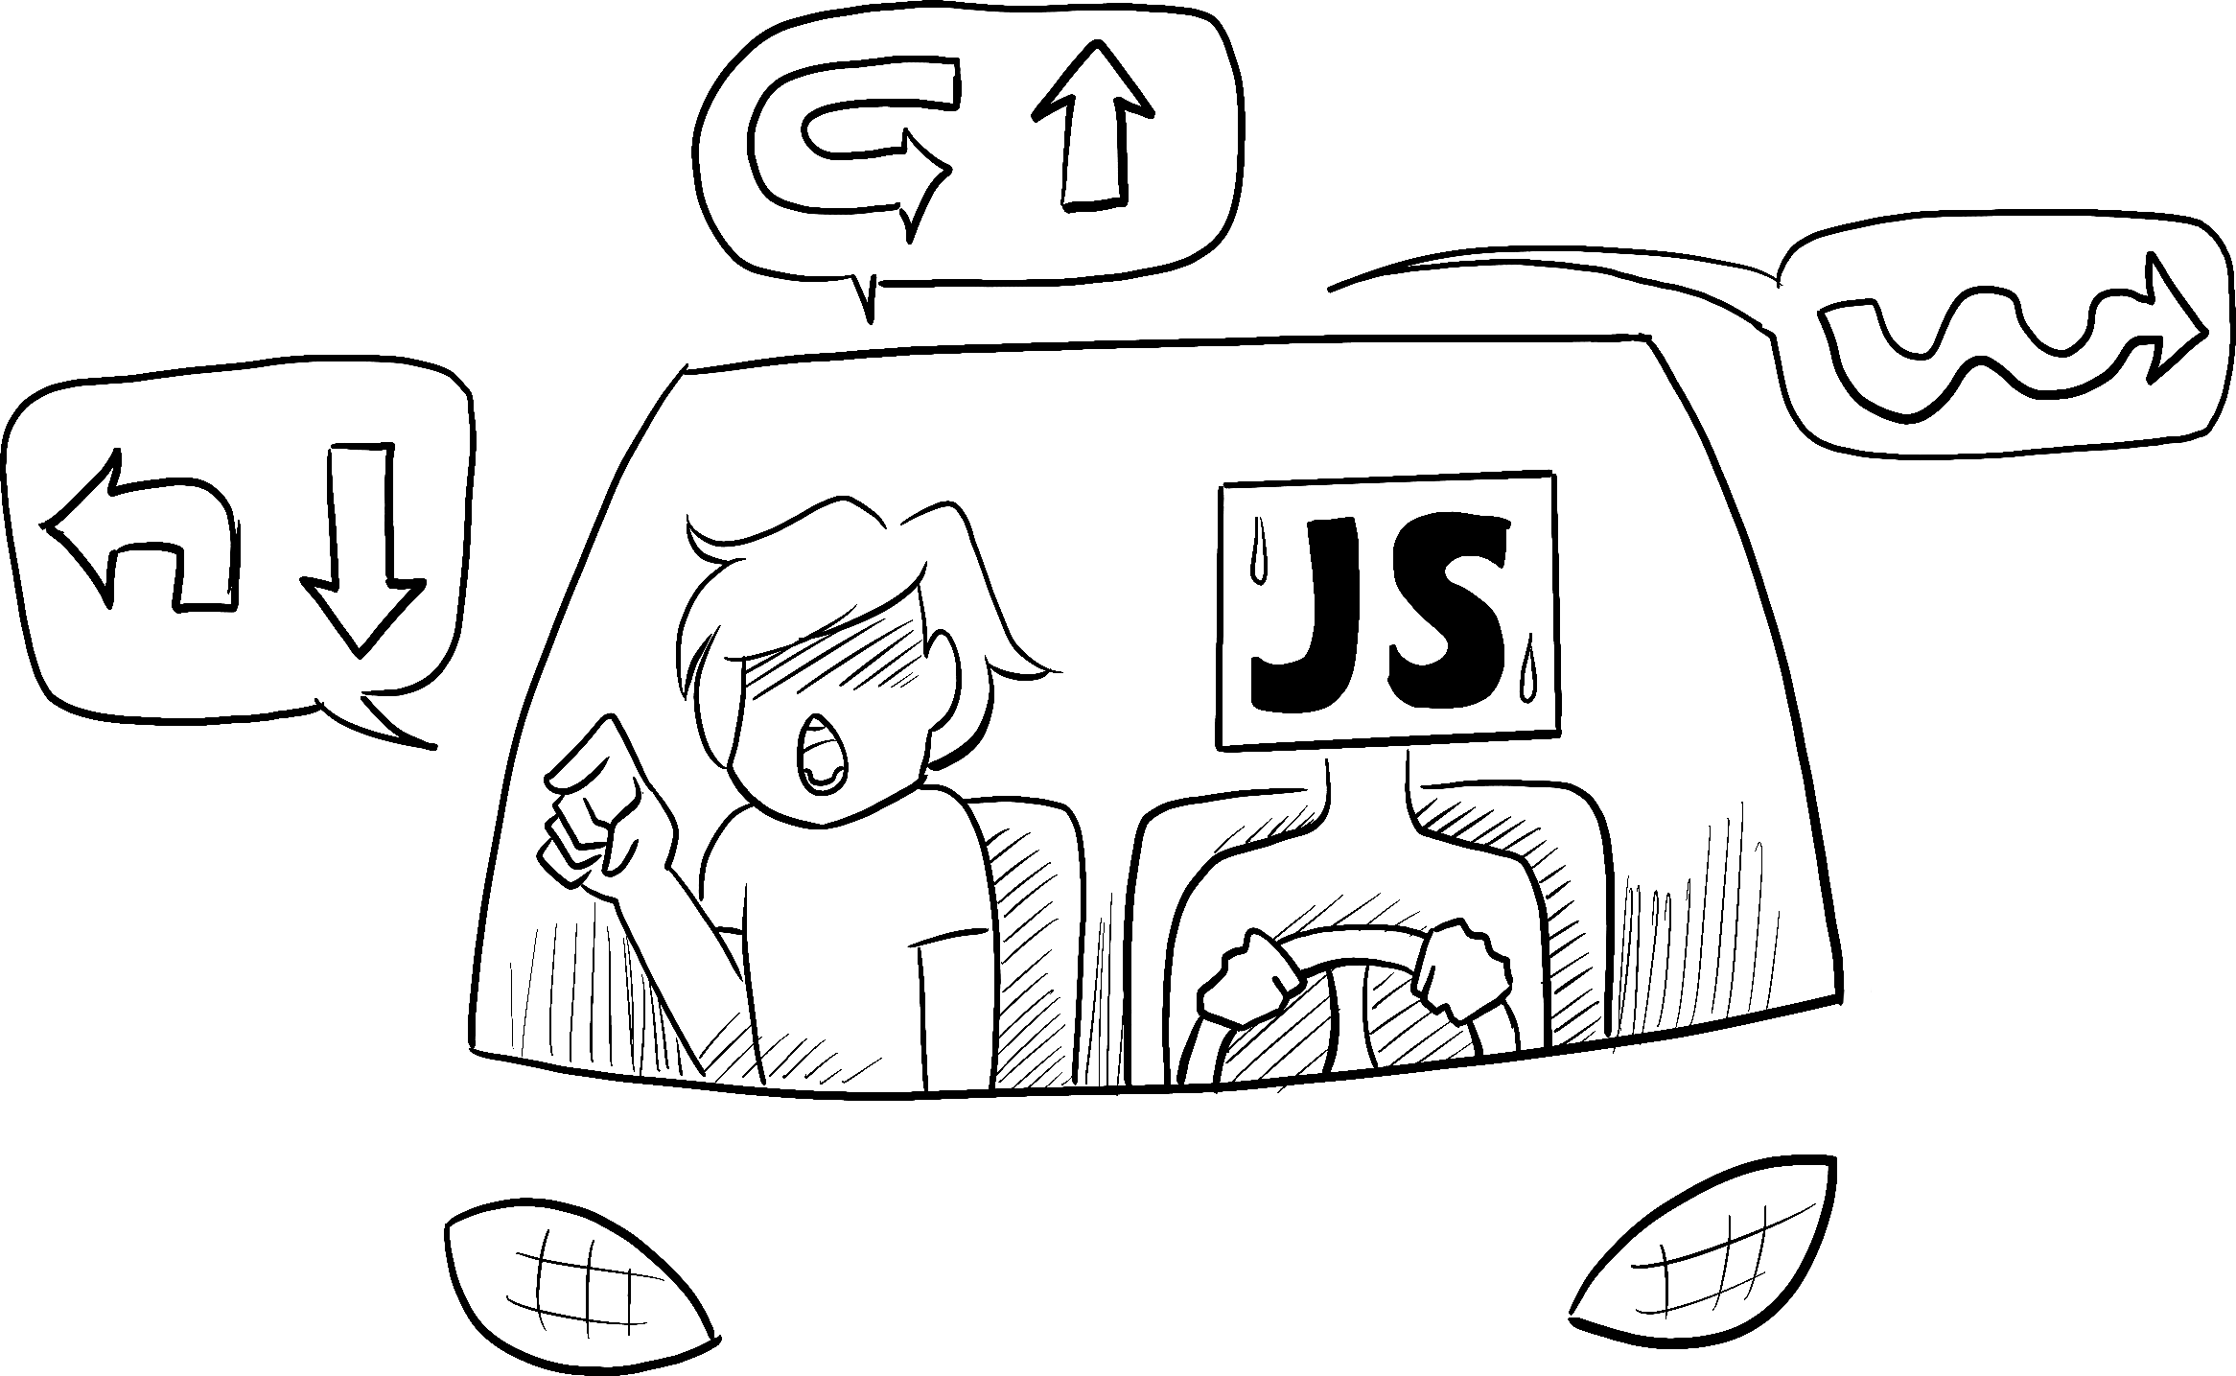
Notes:
IMPERATIVE
Go out of the north exit of the parking lot and take a left. Get on I-15 going North until you get to the 12th street exit. Take a right off the exit like you’re going to Ikea. Go straight and take a right at the first light. Continue through the next light then take your next left. My house is #8963.

Slide 7

Notes:
A declarative response would be
DECLARATIVE
My address is 8963 Eastview Dr Allison Park, PA 15101
In this way, we’re not commanding the driver where to go, potentially making mistakes along the way, but rather, giving the driver the address of where we want to go, and letting the driver figure out the best way to get there (perhaps even knowing about some shortcuts that you didn’t)

Slide 8
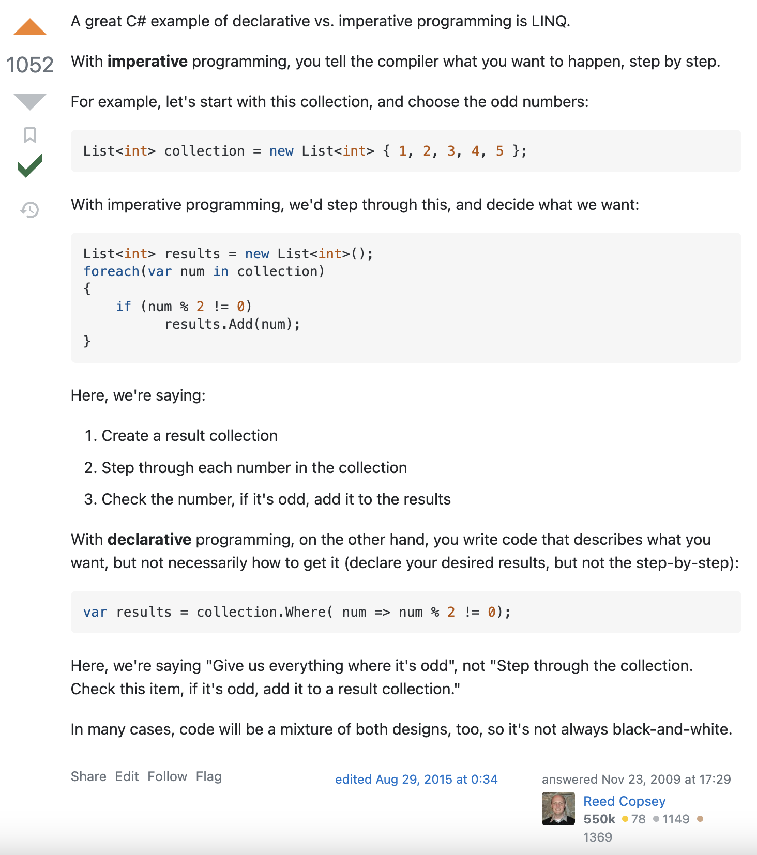
Notes:
Another thing that I come back to in thinking about the difference between imperative and declarative programming is this example in C# I found on Stack Overflow

Slide 9
Demo
Notes:
So let’s get into some demos
“With React, you won’t modify the UI from code directly. For example, you won’t write commands like “disable the button”, “enable the button”, “show the success message”, etc. Instead, you’ll describe the UI you want to see for the different visual states of your component (“initial state”, “typing state”, “success state”), and then trigger the state changes in response to user input. This is similar to how designers think about UI.”

Slide 10
useState
const themeArray = React.useState('light')
const theme = themeArray[0]
const setTheme = themeArray[1]
...
theme // 'light'
setTheme('dark')
theme // 'dark'
Notes:
useState comes built-in with React and can be accessed via React.useState. It takes in a single argument, the initial value for that piece of state, and returns an array with the first item being the state value and the second item being a way to update that state.
The canonical and more precise way to write the code above is to use Array destructuring and put it all on one line. You can see that in the full example here.

Slide 11
useState
function Theme() {
const [theme, setTheme] = React.useState("light");
const toDark = () => setTheme("dark");
const toLight = () => setTheme("light");
return (
<div className={theme}>
{theme === "light" ? (
<button onClick={toDark}>🔦</button>
) : (
<button onClick={toLight}>💡</button>
)}
</div>
);
}
Notes:
The canonical and more precise way to write the code above is to use Array destructuring and put it all on one line. You can see that in the full example here.

Slide 12
useReducer
Notes:
useReducer more complex, not necessary to know as a beginner for simple apps, but is very useful for more complex apps, and a great tool to add to your toolbox as you get more comfortable with React
So, if you get lost here and aren’t able to follow along, don’t feel bad. However, if you have used Redux in our code here, this pattern will be very familiar to you
React comes with a built-in Hook called useReducer that allows you to add state to a function component but manage that state using the reducer pattern.
useReducer returns an array with the first element being the state and the second element being a dispatch function which when called, will invoke the reducer.
When invoked, whatever you pass to dispatch will be passed as the second argument to the reducer (which we've been calling value). The first argument (which we've been calling state) will be passed implicitly by React and will be whatever the previous state value was.
Putting it all together, here's our code.

Slide 13
Demo
Notes:
(Whenever the + button is clicked, dispatch will be invoked. That will call reducer passing it two arguments, state, which will come implicitly from React, and value, which will be whatever was passed to dispatch. What we return from reducer will become our new count. Finally, because count changed, React will re-render the component, updating the UI.)
useState and useReducer both allow you to add state to function components. useReducer offers more flexibility since it allows you to decouple how the state is updated from the action that triggered the update - typically leading to more declarative state updates.
If different pieces of state update independently from one another (hovering, selected, etc.), useState should work fine.
If your state tends to be updated together or if updating one piece of state is based on another piece of state, go with useReducer.
Describing how, imperative with useState
Map actions to state transitions
.. + Reducer contains all of the imperative, instructional code
.. + Update the state based on previous state

Slide 14
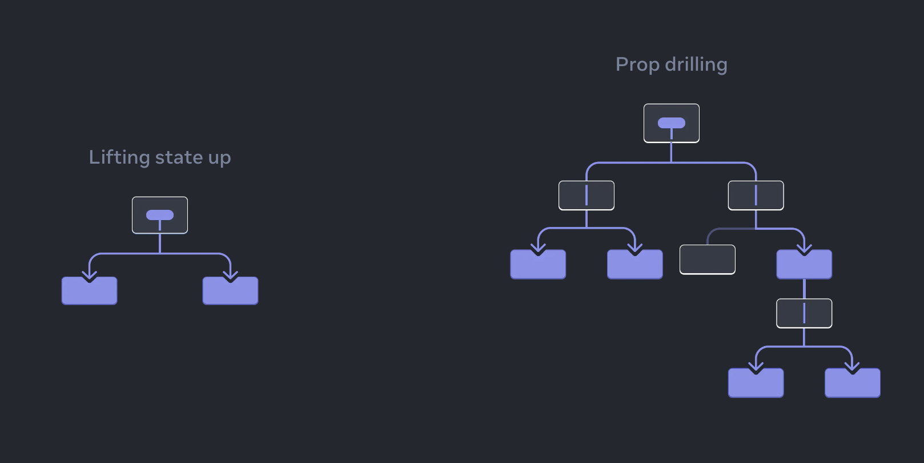
useContext
Notes:
// - context is typically better for libraries (i.e., component libraries)
// - usually, composition should be what you reach for first
Context provides a way to pass data through the component tree without having to pass props down manually at every level. - The React Docs
https://react.dev/learn/passing-data-deeply-with-context

Slide 15
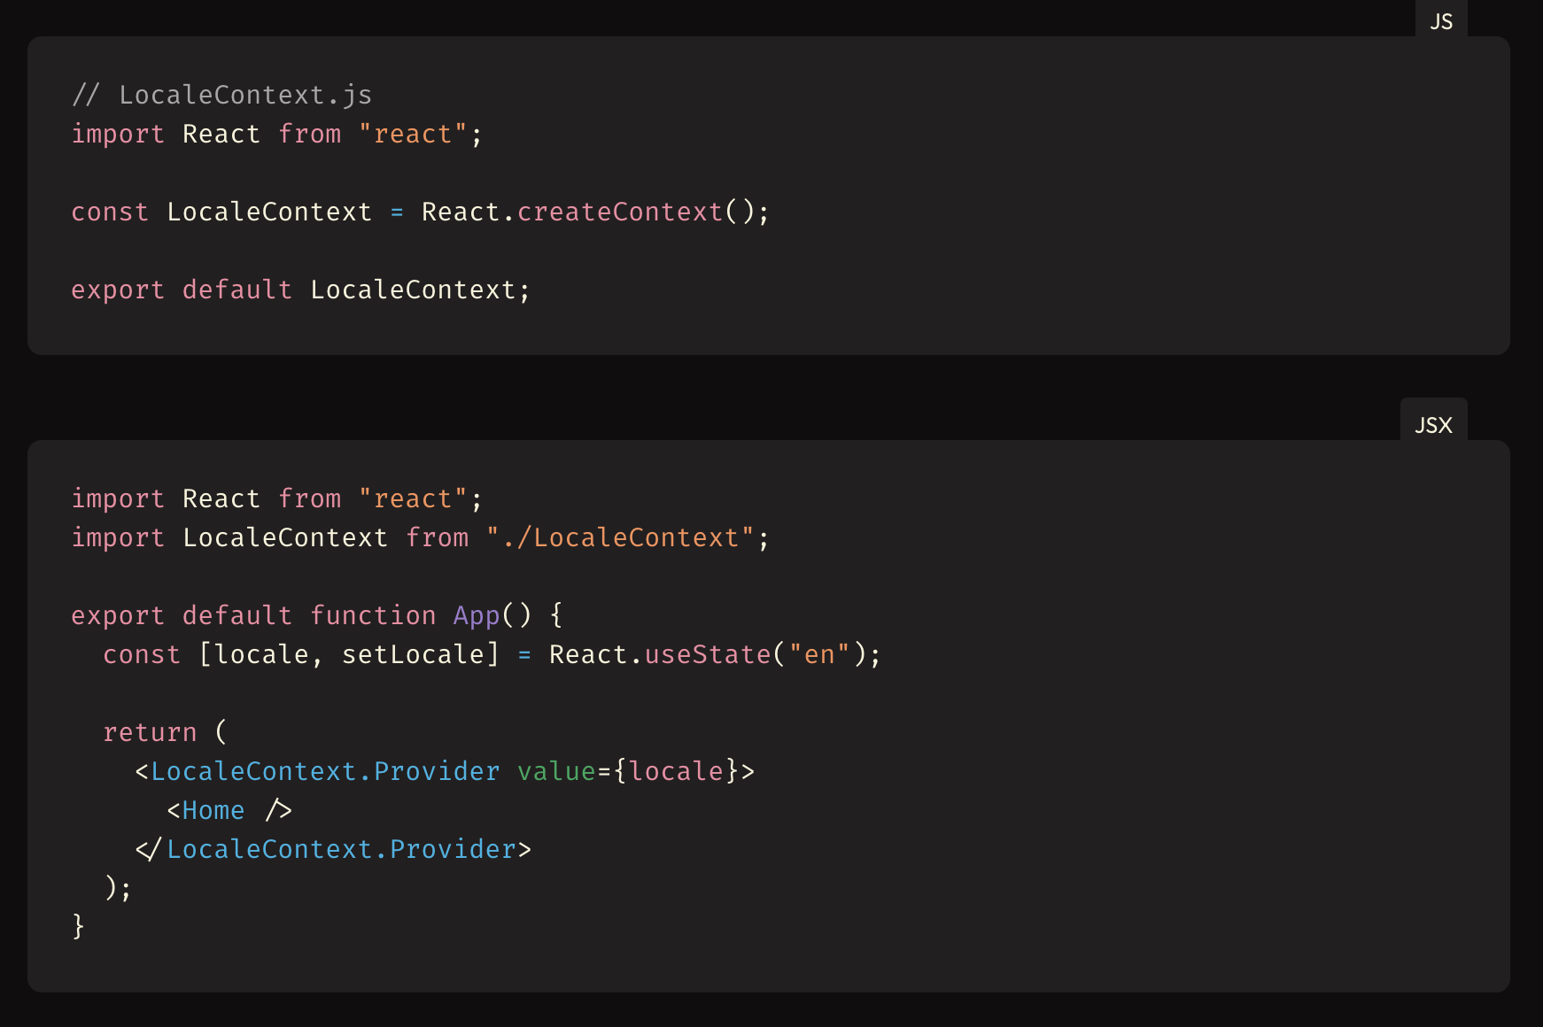
useContext
Provider
Notes:
Context provides a way to pass data through the component tree without having to pass props down manually at every level. - The React Docs
https://react.dev/learn/passing-data-deeply-with-context

Slide 16
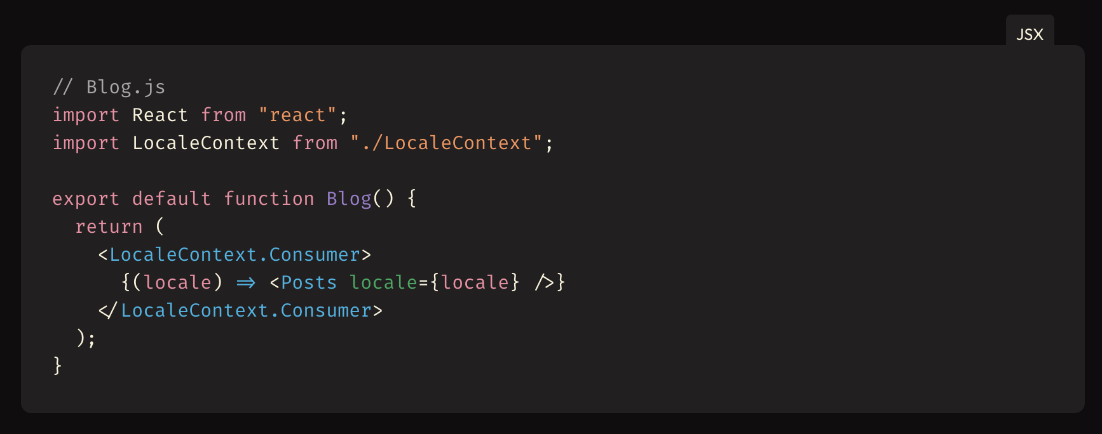
useContext
Consumer
Notes:
Context provides a way to pass data through the component tree without having to pass props down manually at every level. - The React Docs
https://react.dev/learn/passing-data-deeply-with-context

Slide 17
Redux, MobX, others..
Notes:
https://blog.logrocket.com/redux-vs-mobx/

Slide 18


